Slide 1


Tours and Travel Management System
By:
Osama Irfan 21k4772

Slide 2

ABOUT THE PROJECT:
The Tours and Travel Management System is a software based application. The main purpose of “Tours and travels management system” is to provide a convenient way for a customer to book hotels, flight, train and bus for tour purposes.
The objective of this project is to develop a system that automates the processes and activities of a travel agency. In this project, we will make an easier task of searching places and for booking train, flight or bus. In the present system a customer has to approach various agencies to find details of places and to book tickets.

Slide 3

FEATURES:
This system will be able to manage trips of a customer according to their lifestyle,
This system will be able to manage billing record of the customer and can modify it directly through the system.
The system can store customer data which will include their name, gender, age, address and so on.
The system can also login only with admin username and password and can modify user’s data.

Slide 4

FEATURES:
This system also provides a search engine of Google where you can directly search your hotels and tour desires.
System also shows date and time using a special function.
Compiler background color changing feature has also been added.
Automation is also one of the features as every detail can be entered or accessed more efficiently, quicker and with more accuracy.

Slide 5
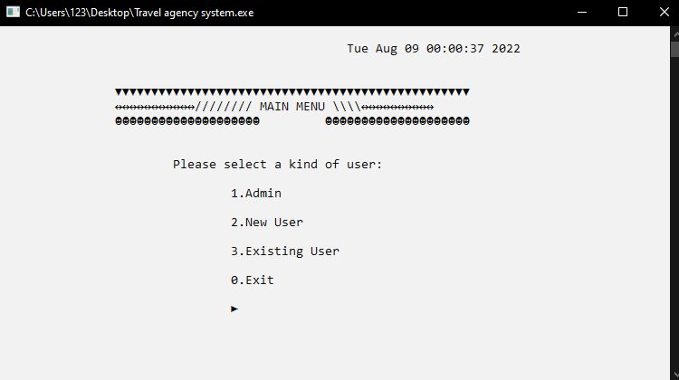
Program Details
Details:
Total 3 classes are made in this program namely, admin, personal details and travel details.
In main menu we can have a choice of admin, new user and Existing user.
In choice 1 we can login to admin,
In choice 2 we can enter personal and travel details.
In choice 3 we can check bill and information and can modify them.

Slide 6
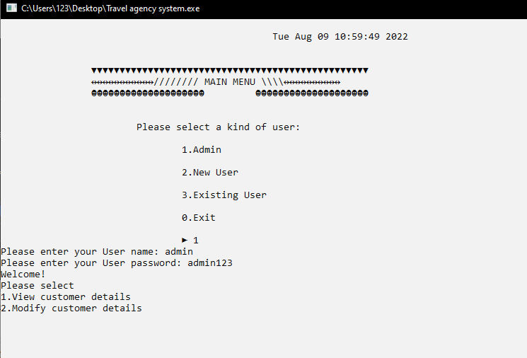
Class Admin
Working:
Can login from username and password and can directly modify customer’s details and can delete them.

Slide 7
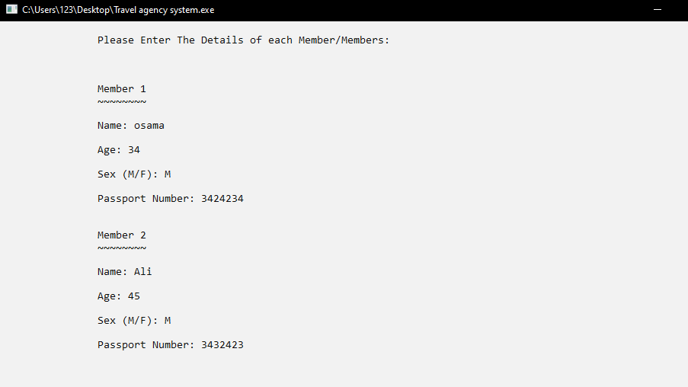
Class Personal Details
Working:
User can enter his and his family’s personal details. All the details would be saved through file handling.

Slide 8
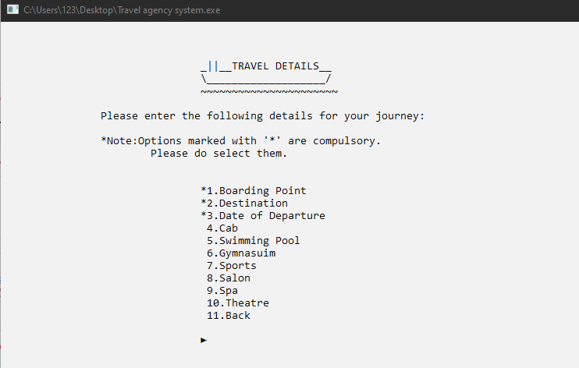
Class Travel Details
Working:
User can add his/her travel details including hotel, car, destinations, and can search his/her favourite hotel from an automatic search engine. Calculates bill and can modify the details. All the details would be saved through file handling.

Slide 9
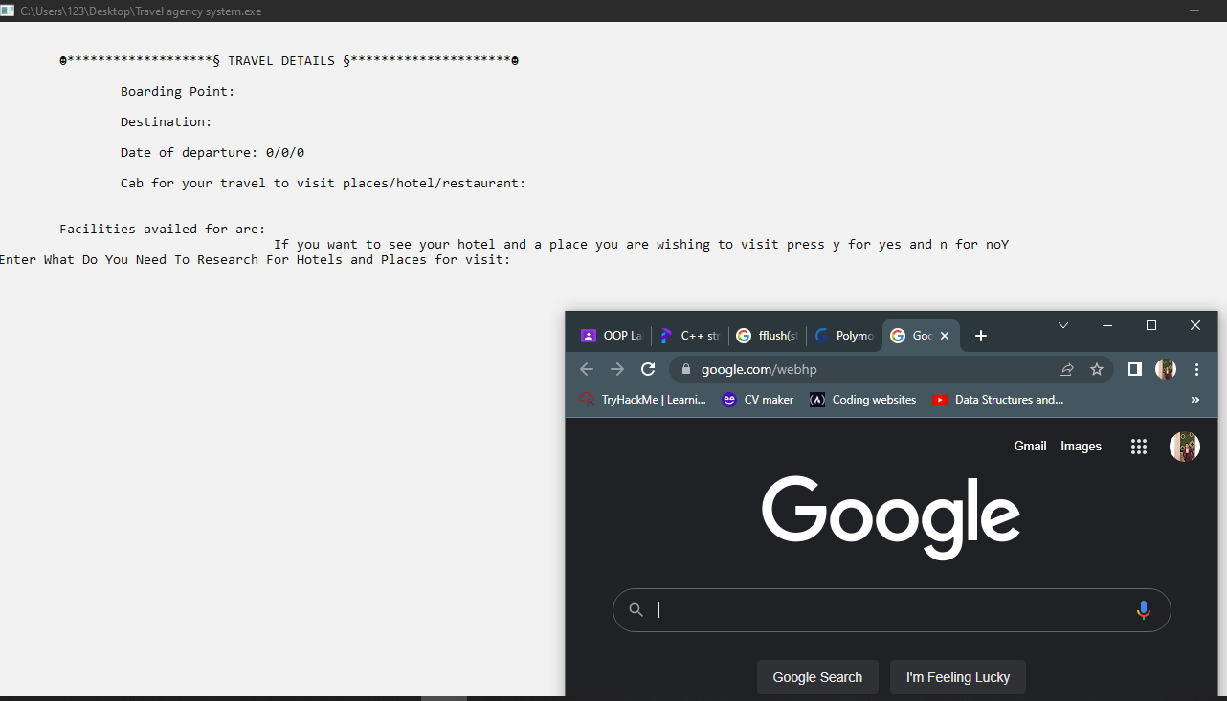
Special Feature:
We have a special feature in the program by which we can automatically access to Google search engine to search our desires:

Slide 10

THANK YOU! Moving Towards the Code:
Managers:
Osama Irfan
Phone:
678-555-0128
Email: toursandtravel@gmail.com

